Slide 1
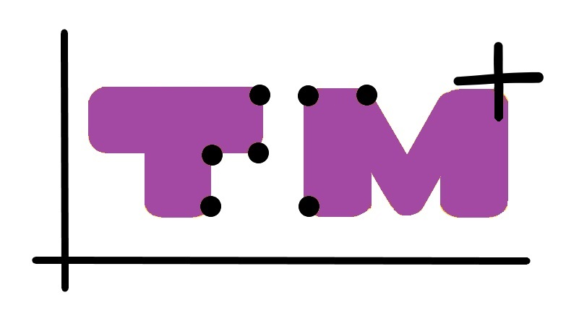
Graphs under your fingertips ⡛⠗⠁⠏⠓⠎⠀⠥⠝⠙⠑⠗⠀⠽⠕⠥⠗⠀⠋⠊⠝⠛⠑⠗⠞⠊⠏⠎
Getting In Touch With Literacy
November 29 – December 2, 2023 St. Pete Beach, Florida

Slide 2
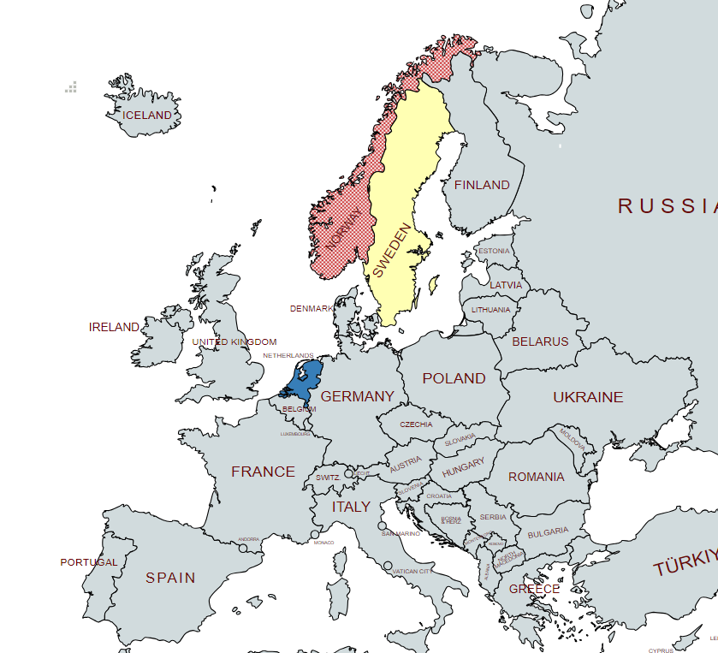
TouchingMaths⁺ august 2022- august 2025

Slide 3
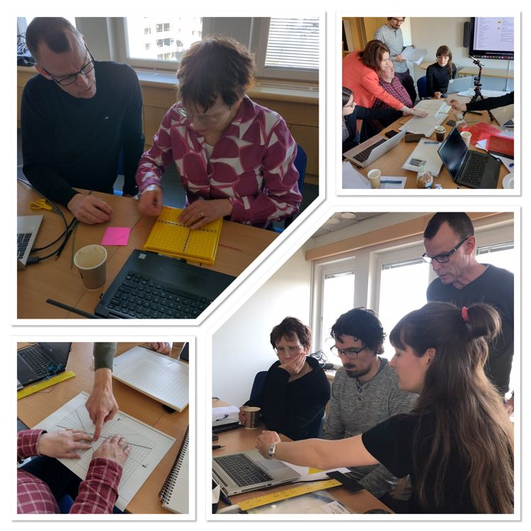
Meeting in the Netherlands (2022) and Sweden (2023)

Slide 4
Experience verbal description
Instructor

Slide 5
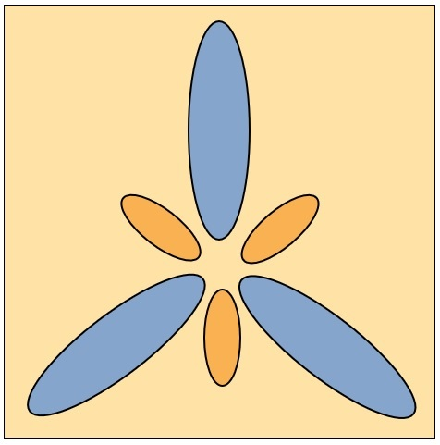
3 types of descriptions:
Very detailed descriptions that often include unnecessary information
The drawing consists of 6 ovals.3 large ovals in blue and 3 small ovals in light brown. The 6 ovals are placed in a beige square. The 3 large ovals are in a circle with the points towards the center. The 3 small ovals are placed in between. The whole thing resembles an abstract flower.
A description that omits redundant information
A description that omits redundant information and uses mathematical language. Sometimes some extra information is even added.
3 identical small and 3 identical large elliptical figures are placed in a circle in such a way that the figure is rotationally symmetrical with a rotation angle of 120 degrees. The rotation point is the center of the circle.

Slide 6
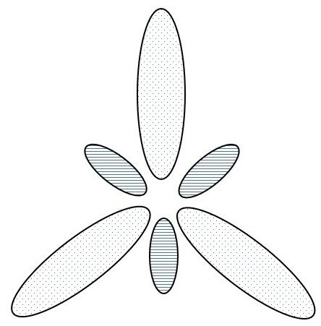
3 types of descriptions:
Very detailed descriptions that often include unnecessary information
A description that omits redundant information
A description that omits redundant information and uses mathematical language. Sometimes some extra information is even added.
3 identical small and 3 identical large elliptical figures are placed in a circle in such a way that the figure is rotationally symmetrical with a rotation angle of 120 degrees. The rotation point is the center of the circle.

Slide 7
3 types of descriptions:
Very detailed descriptions that often include unnecessary information
A description that omits redundant information
A description that omits redundant information and uses mathematical language. Sometimes some extra information is even added.
3 identical small and 3 identical large elliptical figures are placed in a circle in such a way that the figure is rotationally symmetrical with a rotation angle of 120 degrees. The rotation point is the center of the circle.

Slide 8
What constitutes an effective verbal description for a drawing, picture, or 3D model depends on several factors:
The intended purpose of the drawing or picture.
The skills and knowledge of the Braille reader involved.
Whether the description is designed to serve as a substitute for the tactile drawing or 3D model.
Whether the description aims to enhance, strengthen, or repeat the information conveyed through the tactile drawing or 3D model.

Slide 9
EMCC The Extended Mathematical Core Curriculum
The questions we aim to address are as follows:
What additional knowledge and skills do Braille readers need to acquire, beyond those required by sighted students, in order to meet the learning objectives outlined in the Mathematical Core Curriculum (MCC)?
How can they obtain this additional knowledge and these skills?

Slide 10
EMCC The Extended Mathematical Core Curriculum
Final products:
Description of EMCC for graphs, equations and computational thinking / programming. This involves:
Instruction on braille reading, tactile reading and ICT-skills
(braille, tactile and digital literacy)
Instruction for math teachers of Braille readers
Document ‘Learning Resources’

Slide 11
EMCC The Extended Mathematical Core Curriculum
Today the focus is on the EMCC for graphs.

Slide 12
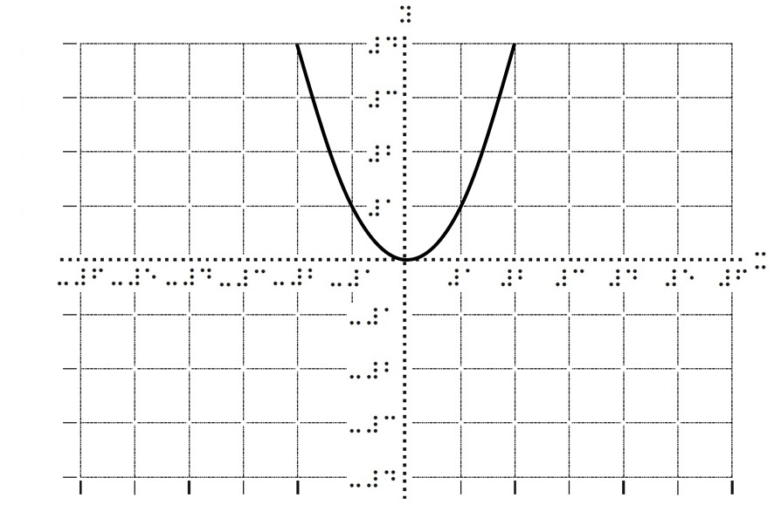
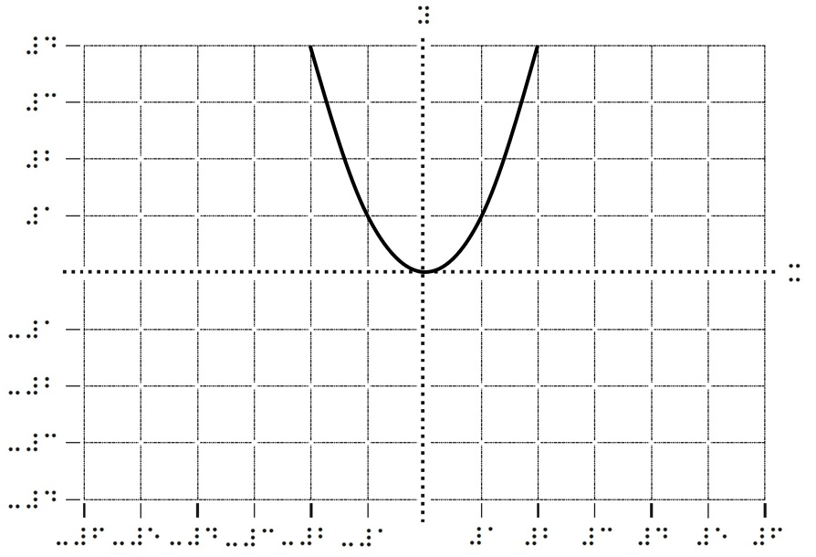
Instruction on braille and tactile reading (provided by TVI teachers, for example)

Slide 13
Instruction guide for math teachers
The math teacher:
1) is primarily responsible for the math education of the Braille reader. This will promote inclusion.
2) must understand and anticipate how the use of Braille reader devices affects teaching and learning.

Slide 14
New device for all students: coordinate system with movable axes
The figure shows a (tangible) point A and a coordinate system with movable axes.

Slide 15
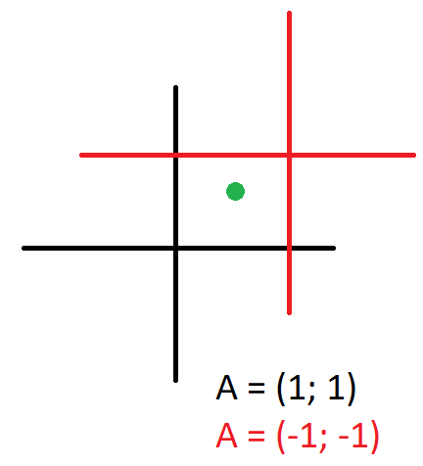
New device for all students: coordinate system with movable axes

Slide 16
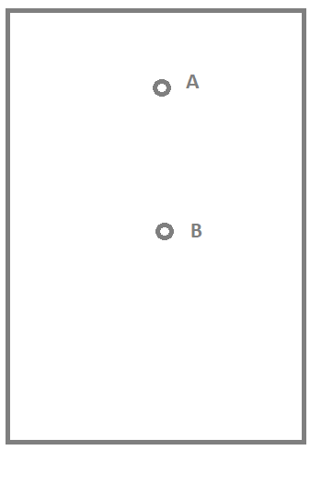
Exercise
Draw points A and B on a piece of paper so that point B is directly below point A.

Slide 17
Exercise
Draw a coordinate system on a sheet of paper such that
A = (2, 4) and B = (2, -4).

Slide 18
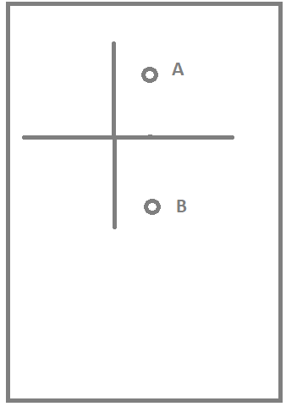
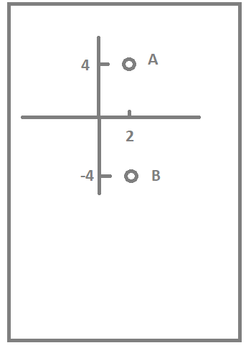
Exercise
A = (2; 4) and B = (2; -4)

Slide 19
Body-graphs for all students
x-axis is on chest height, y -axis is a vertical line from your head to your feat.

Slide 20
y = x²

Slide 21
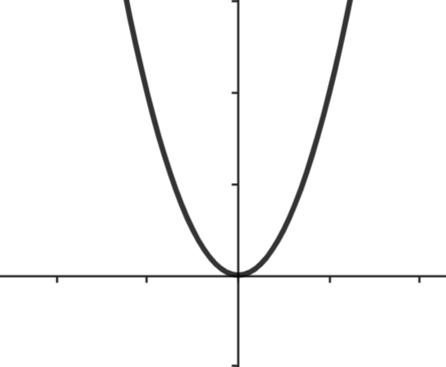
Standard
y = x²

Slide 22
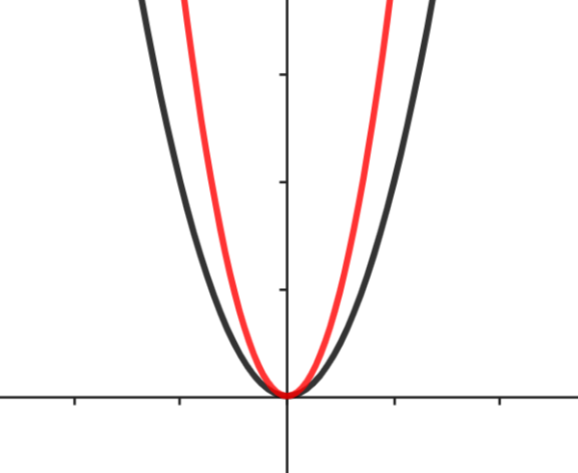
Smaller
y = 2x²

Slide 23
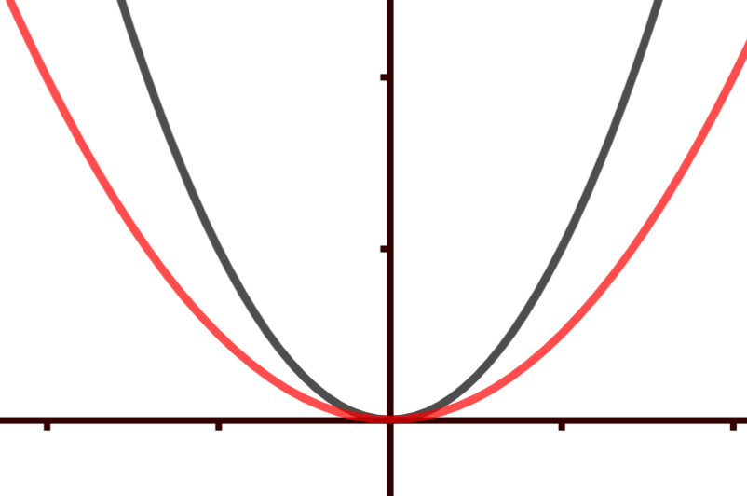
Wider
y = 0.5 x²

Slide 24
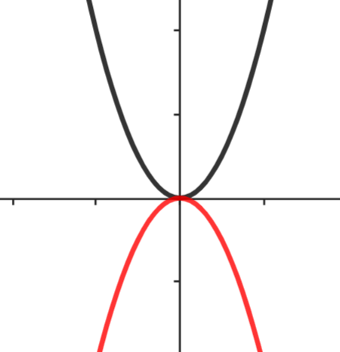
Valley, standard
y = -x²

Slide 25
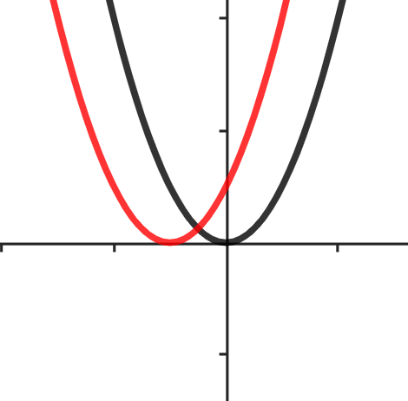
Standard
Left
y = (x + 1)²

Slide 26
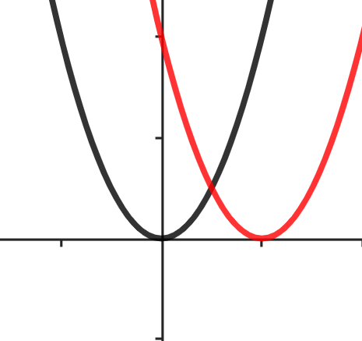
Standard
Right
y = (x – 2)²

Slide 27
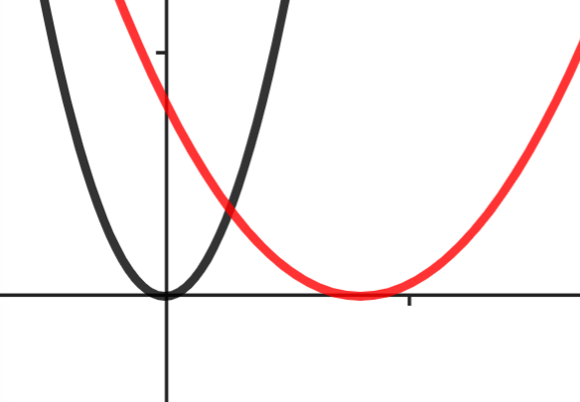
Wider
Right
y = (0.5x – 2)²

Slide 28
Finally
y = 0.2 x² → y = 0.4 x² → y = 0.6 x² → y = 0.8 x² → y = 1 x²
→ y = 2 x² → y = 4 x² → y = 6 x² → y = 8 x² → 10 x^2
^{Applause for yourself}

Slide 29
Start Body Graph Dancing

Slide 30
Enjoy the Music
Get ready for Body Graph Dancing

Slide 31
Enjoy the Music
Get ready for Body Graph Dancing

Slide 32
Enjoy the Music
Get ready for Body Graph Dancing

Slide 33
Enjoy the Music
Get ready for Body Graph Dancing

Slide 34
Enjoy the Music
Get ready for Body Graph Dancing

Slide 35
Enjoy the Music
Get ready for Body Graph Dancing

Slide 36
Enjoy the Music
Get ready for Body Graph Dancing

Slide 37
Enjoy the Music
Get ready for Body Graph Dancing

Slide 38
y = x²

Slide 39
Standard
y = x²

Slide 40
y = 2x²

Slide 41
Smaller
y = 2x²

Slide 42
y = 0.5 x²

Slide 43
Wider
y = 0.5 x²

Slide 44
y = -x²

Slide 45
Valley, standard
y = -x²

Slide 46
y = (x + 1)²

Slide 47
Standard
Left
y = (x + 1)²

Slide 48
y = (x – 2)²

Slide 49
Standard
Right
y = (x – 2)²

Slide 50
y = (0.5x – 2)²

Slide 51
Wider
Right
y = (0.5x – 2)²

Slide 52
Finally

Slide 53
y = 0.2 x²

Slide 54
y = 0.4 x²

Slide 55
y = 0.6 x²

Slide 56
y = 0.8 x²

Slide 57
y = x²

Slide 58
y = 2x²

Slide 59
y = 4x²

Slide 60
y = 6x²

Slide 61
y = 8x²

Slide 62
y = 10x²

Slide 63
_{Applause}

Slide 64
_{Applause}

Slide 65
_{Prepare for the last part}

Slide 66
_{Prepare for the last part}

Slide 67
_{Prepare for the last part}

Slide 68
_{Prepare for the last part}

Slide 69
y = 0.2 x²

Slide 70
y = 0.4 x²

Slide 71
y = 0.6 x²

Slide 72
y = 0.8 x²

Slide 73
y = x²

Slide 74
y = 2x²

Slide 75
y = 4x²

Slide 76
y = 6x²

Slide 77
y = 8x²

Slide 78
y = 10x²

Slide 79
_{Applause}

Slide 80
_{Thank you}

Slide 82
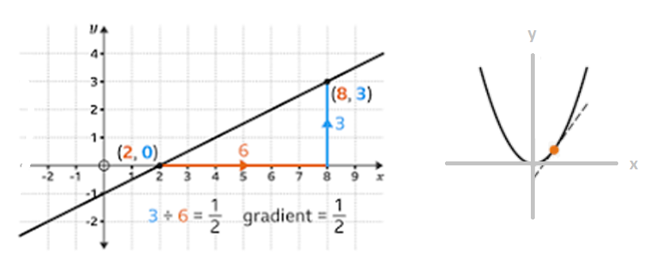
Gradient
→

Slide 83
Melody: row row row the boat
The gradient
Gradient of a line is easy to define
Gradient is the measure of the steepness of a line
Gradient of a line is simple to be found
Change in y over change in x and that’s the gradient

Slide 84
Website of our project: touchingmaths.eu
Introduction by TorbjørnSimmenes

Slide 85
⠉⠕⠝⠞⠁⠉⠞
Thank you for your attention.
If you have any questions, please contact me or visit our website.
Of course you can also contact us during the conference. We would be happy to tell you more about our project.
Annemiek van Leendert, PhD
annemiekvanleendert@visio.org
A.J.M.vanLeendert@uu.nl

